Slide 1
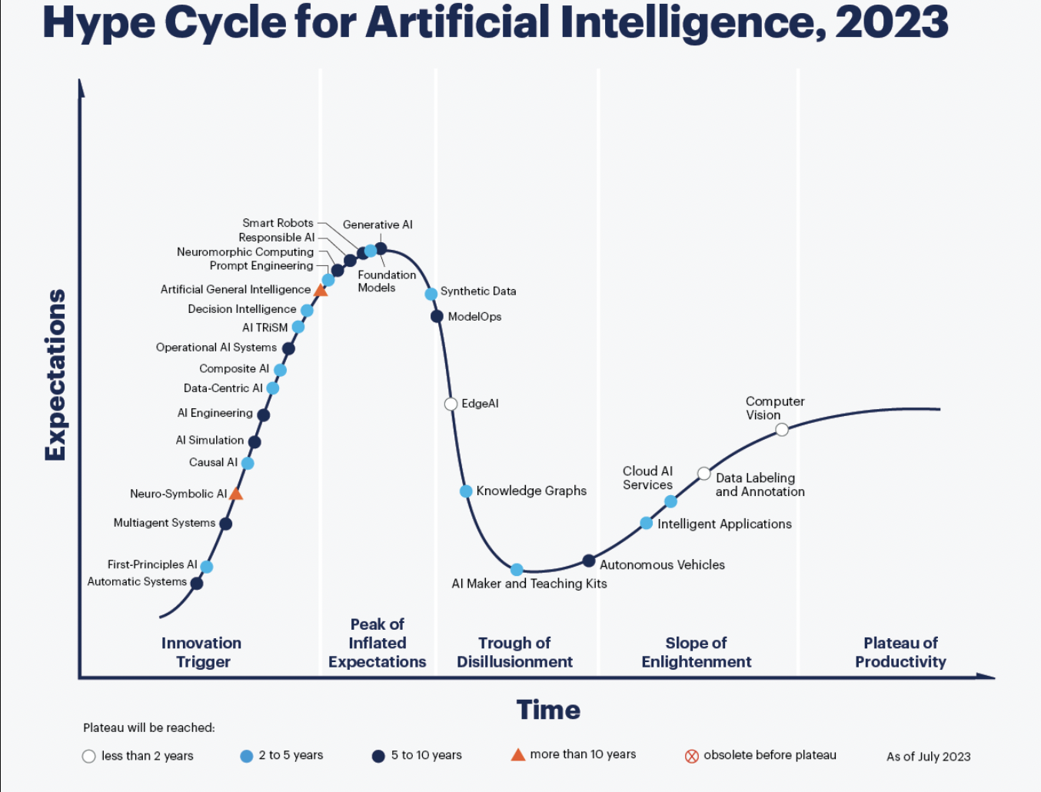
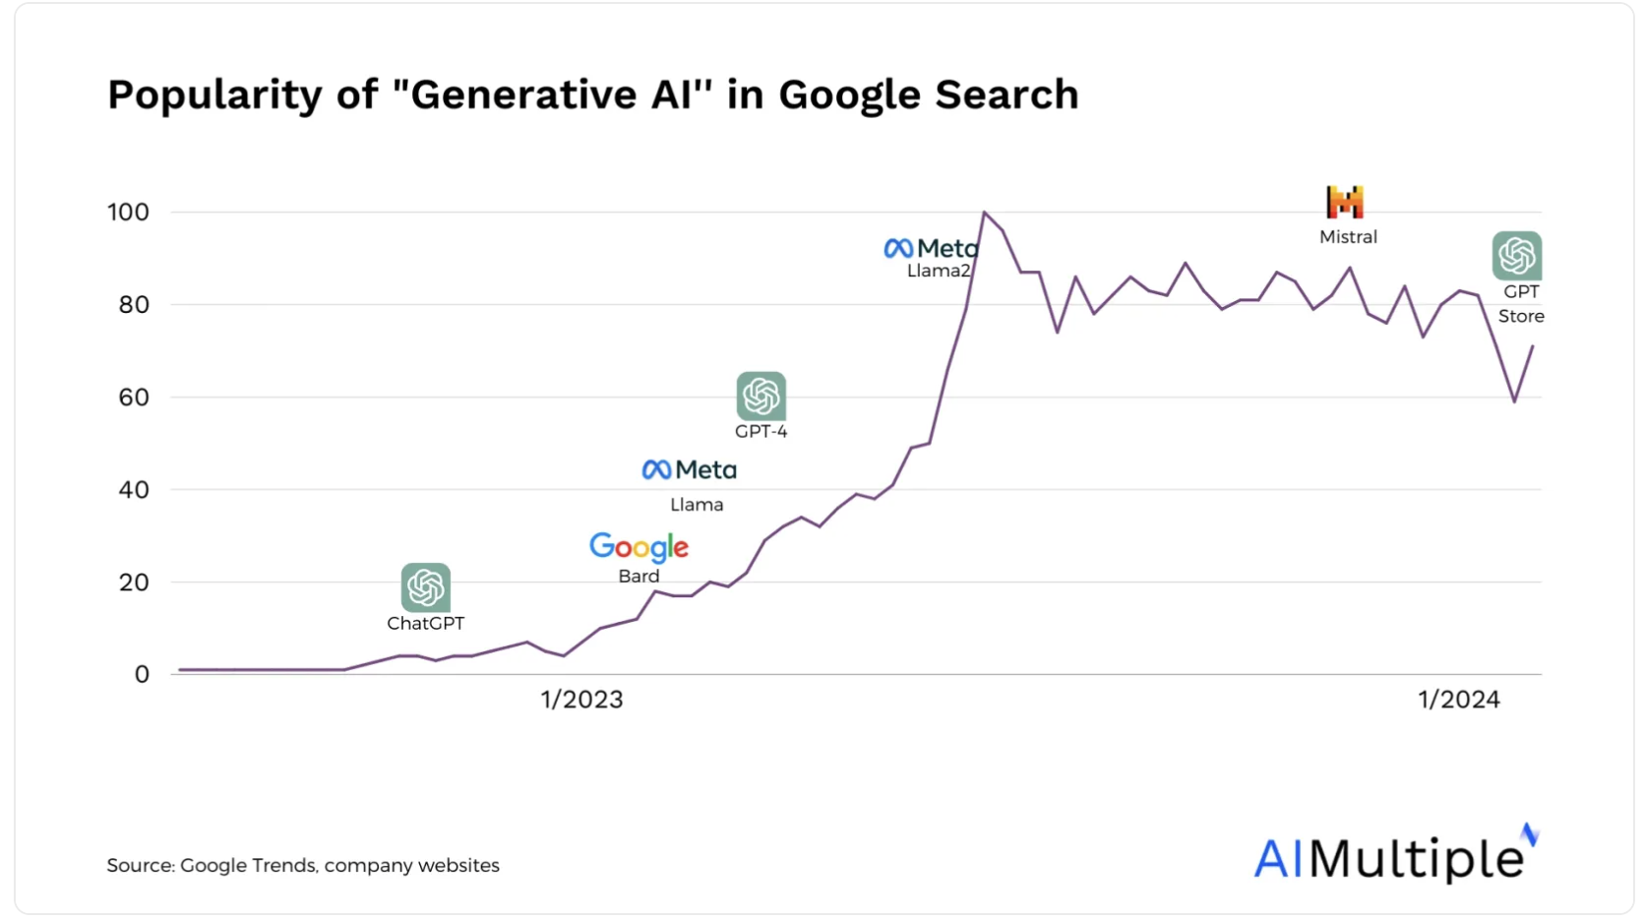

Slide 2


Slide 3
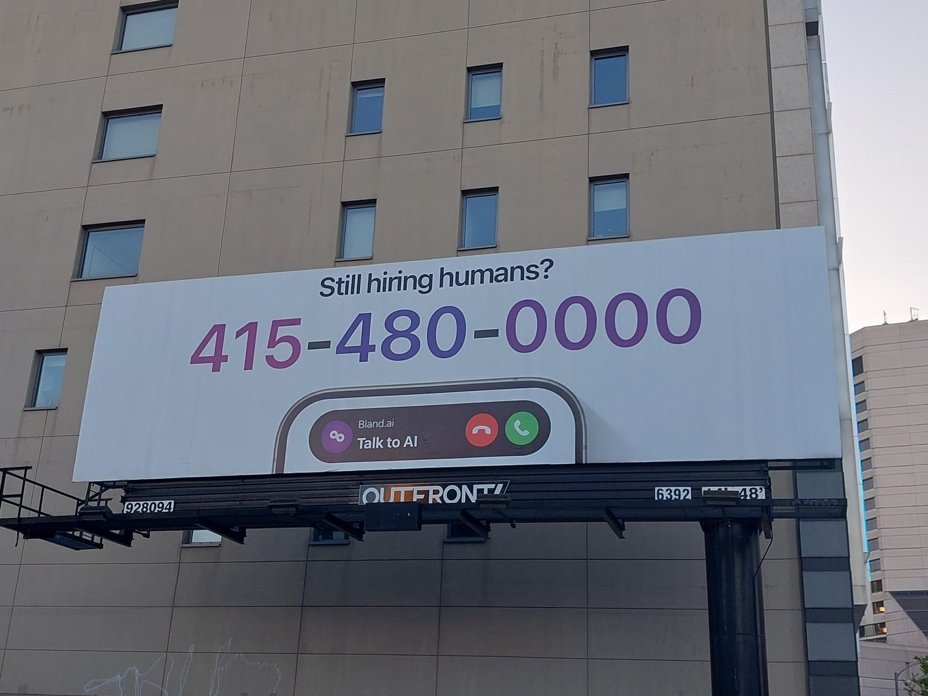
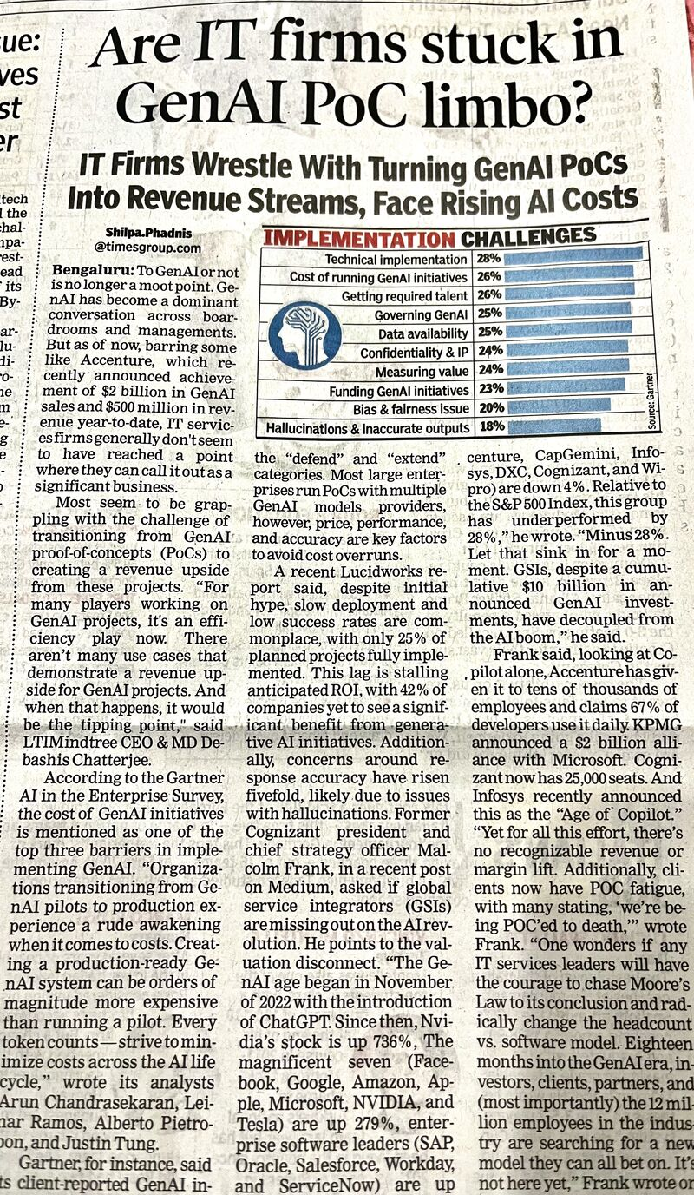
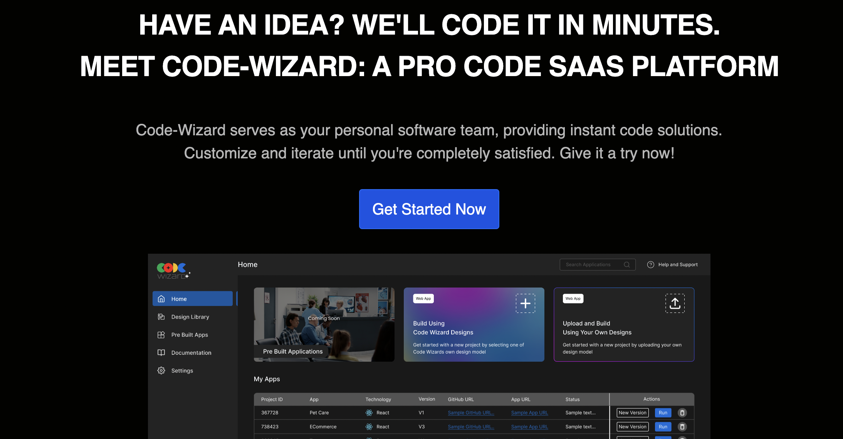
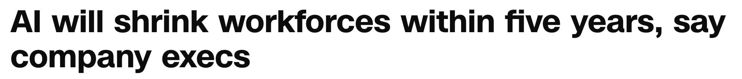
https://edition.cnn.com/2024/04/05/business/ai-job-losses/index.html

Slide 4
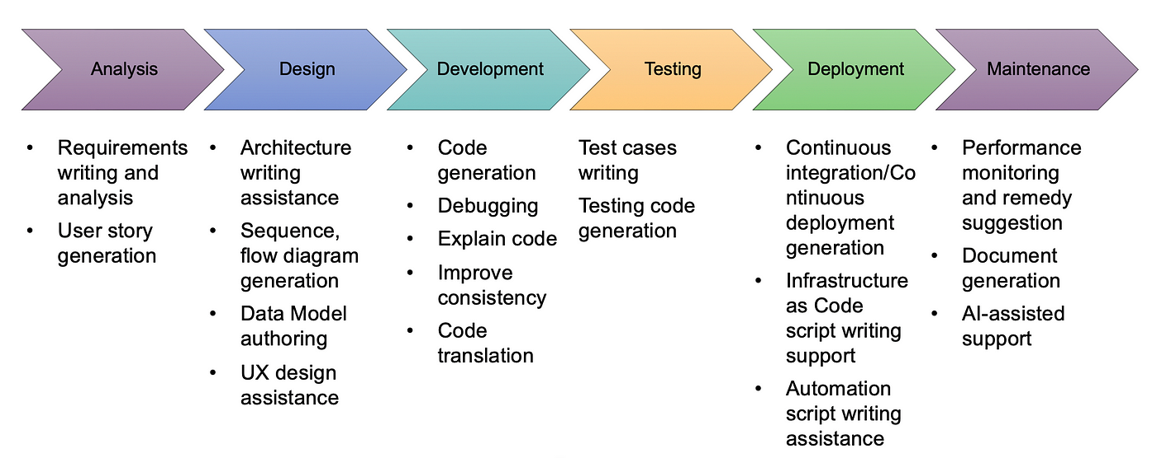

Slide 5
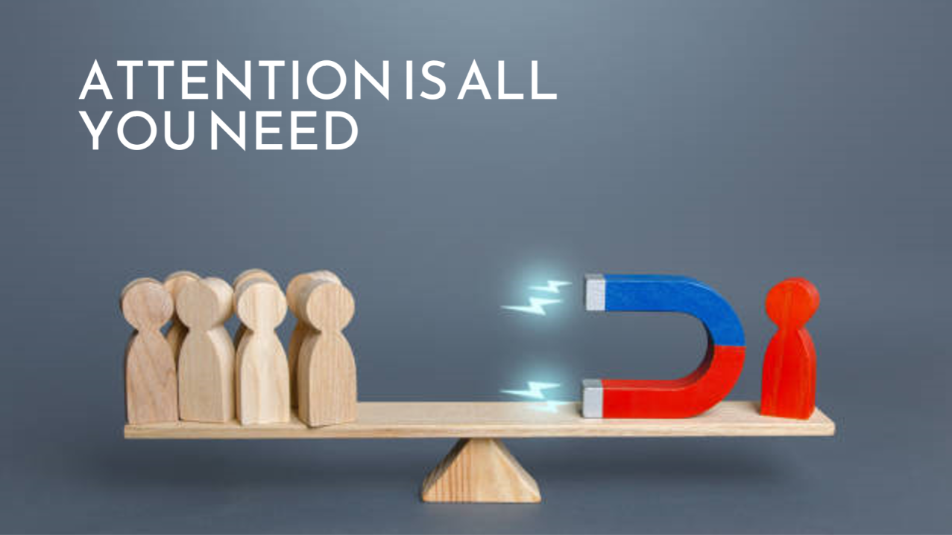

Slide 6
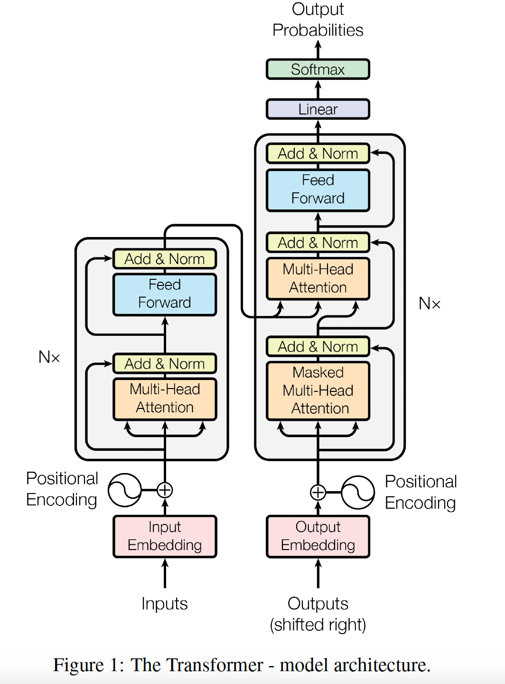
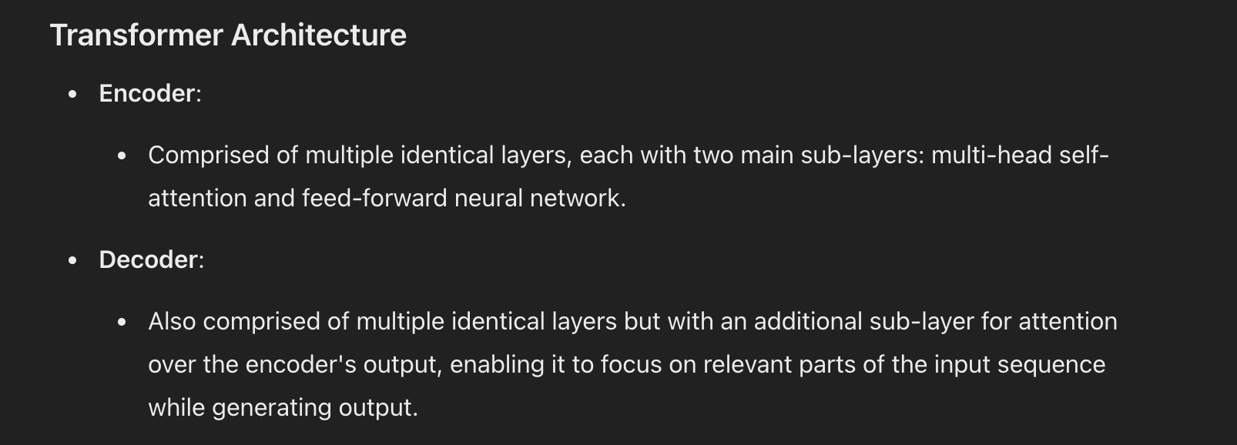

Slide 7
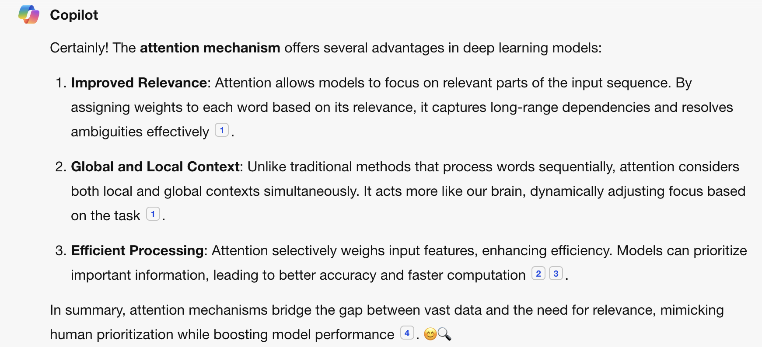

Slide 8
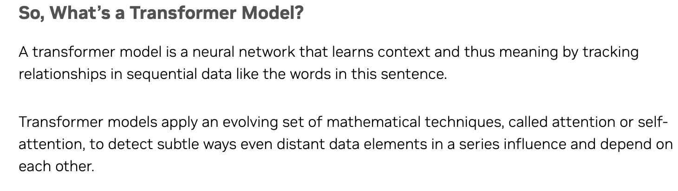
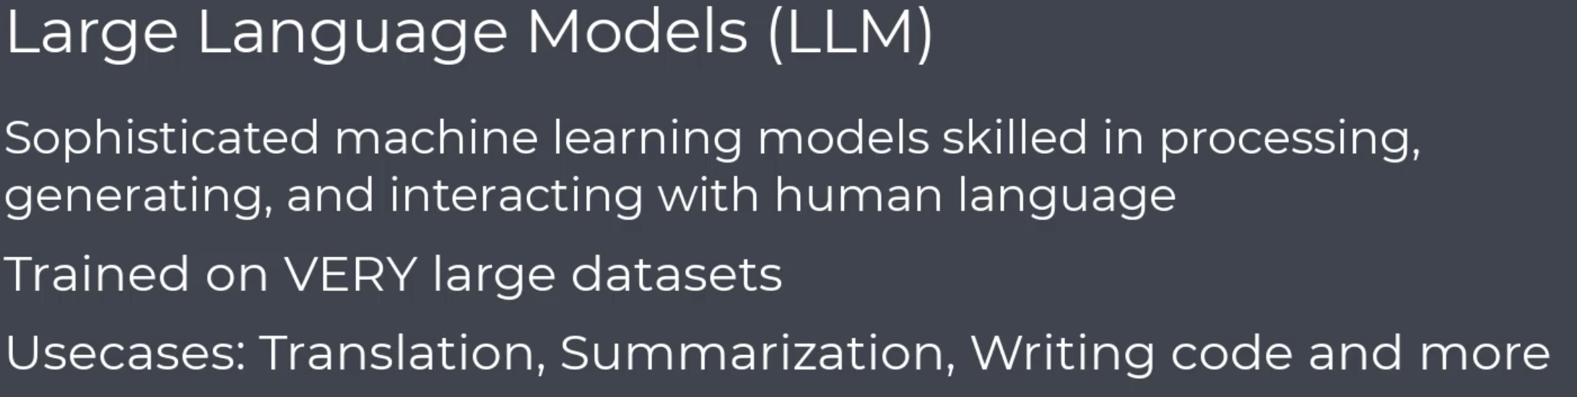

transformers master language by breaking it down into manageable chunks (tokens), giving each chunk a numeric identity (embeddings), and then working with these chunks to produce meaningful outputs.

Slide 9
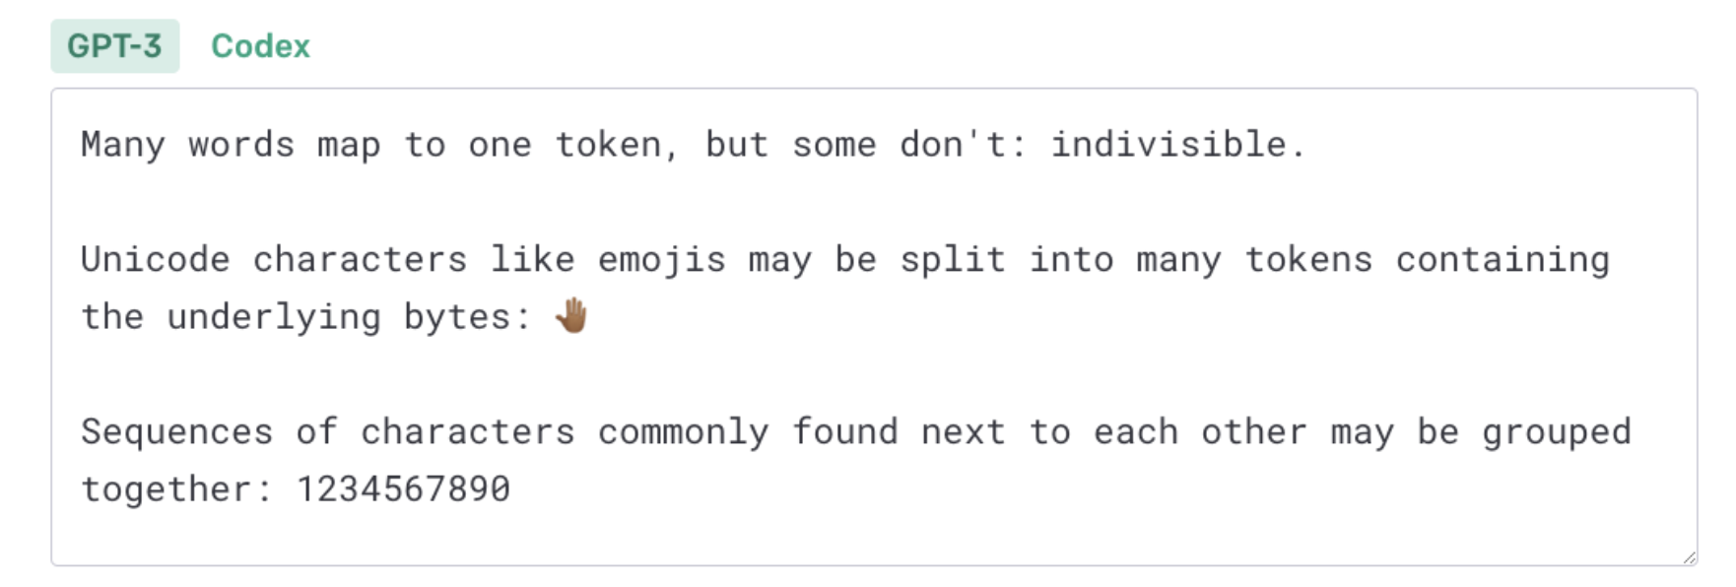
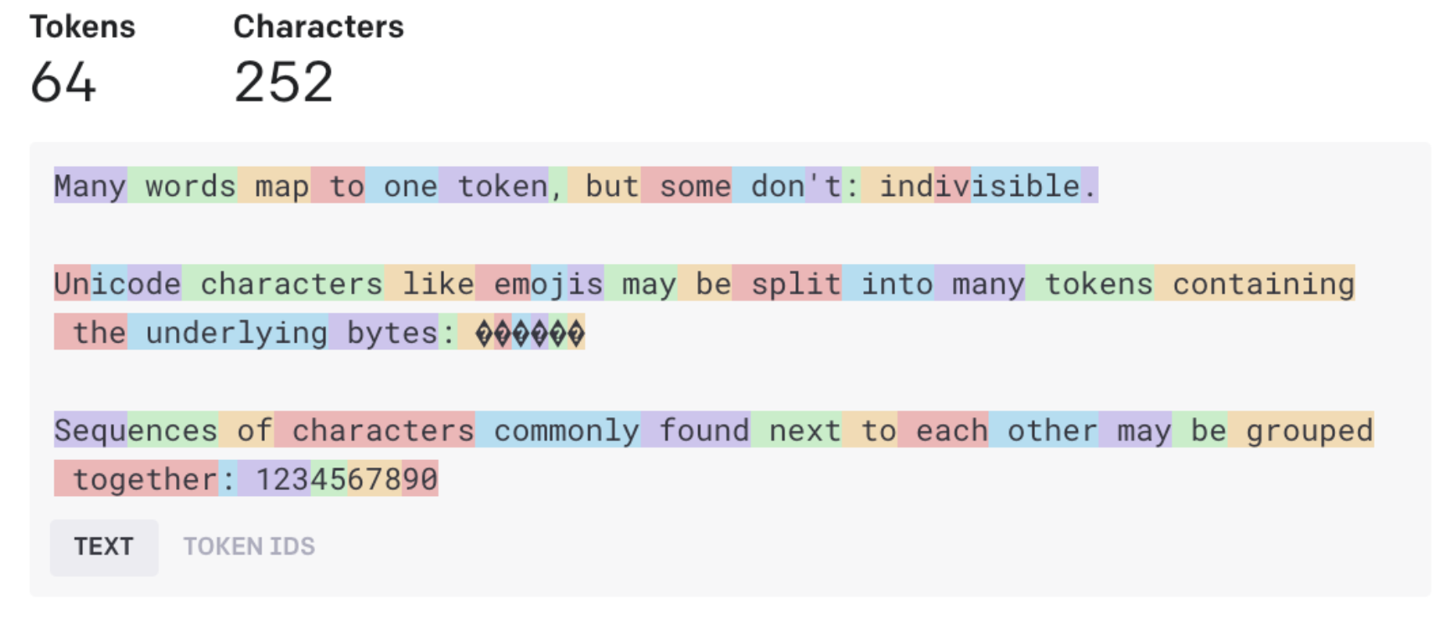
You can think of sentences and words as molecules, whereas tokens are the atoms that make them up
Tokens are the representations of text in the form of a vector.
By converting language into tokens, AI transformers can build meaning from language

Slide 10
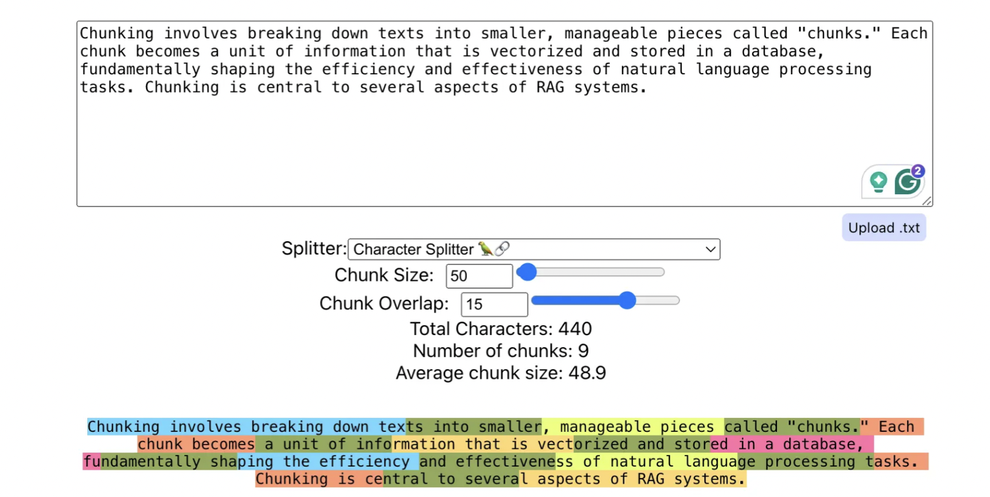
Retrieval quality
Vector database cost
Vector database query Latency
LLM latency and cost
LLM hallucinations

Slide 11
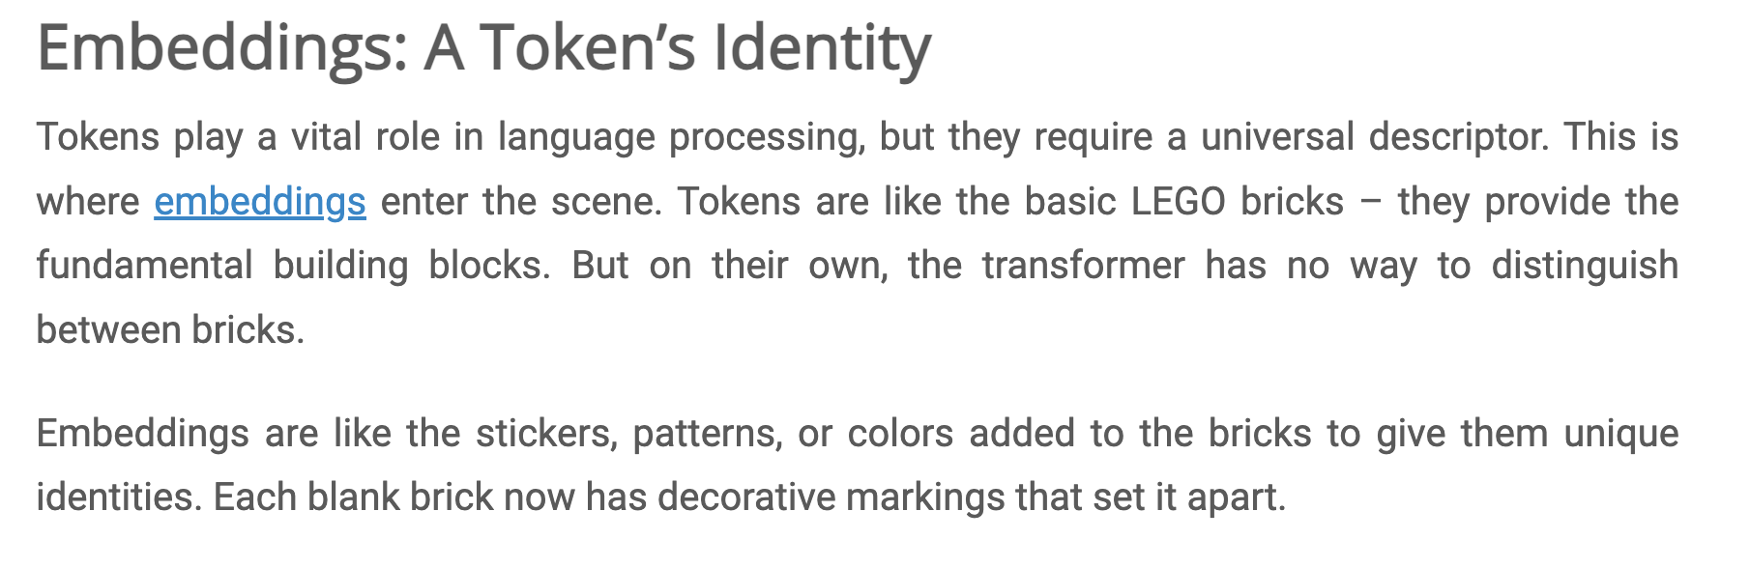
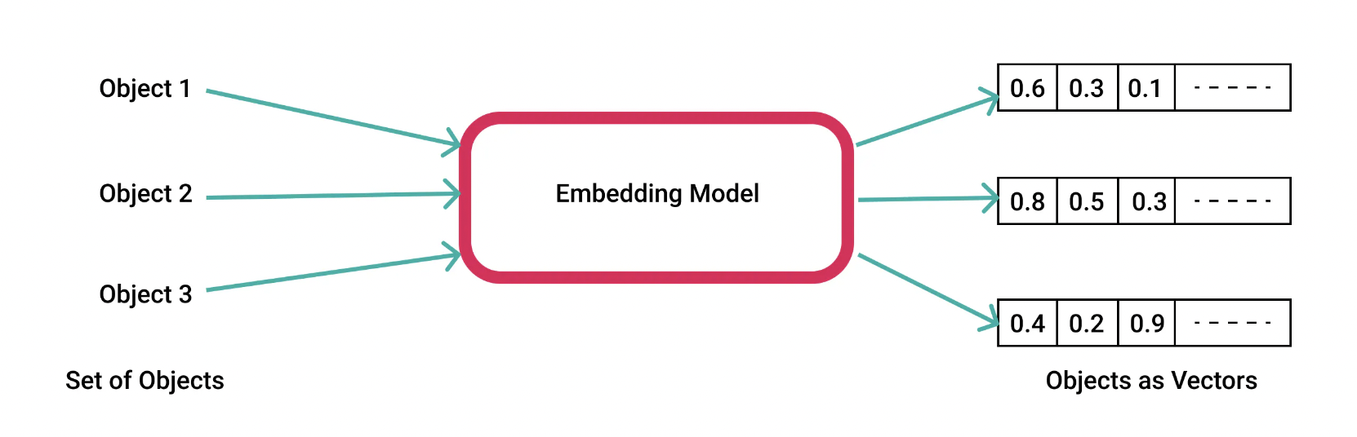

Slide 12
Tokens vs. Vectors: Tokens are the linguistic units, while vectors are the mathematical representations of these units. Every token is mapped to a vector in the LLM’s processing pipeline.
Vectors vs. Embeddings: All embeddings are vectors, but not all vectors are embeddings. Embeddings are vectors that have been specifically trained to capture deep semantic relationships.
Tokens and Embeddings: The transition from tokens to embeddings represents the movement from a discrete representation of language to a nuanced, continuous and contextually aware semantic space.
****************************
Text is tokenized into discrete units called **tokens**.
These tokens are converted into continuous numerical representations called **embeddings**.
Embeddings are stored and manipulated as **vectors**.

Slide 13
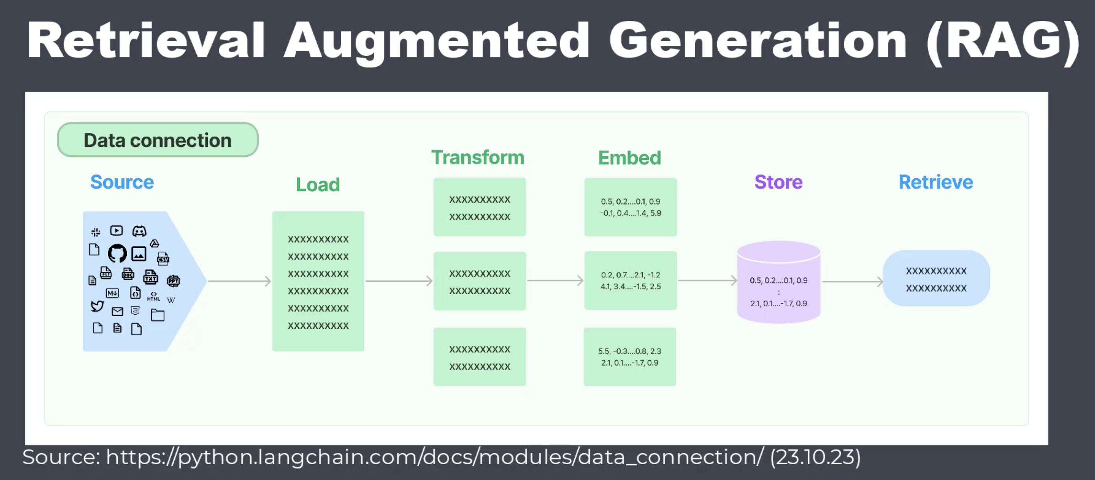
What Is Retrieval-Augmented Generation, aka RAG?
Retrieval-augmented generation (RAG) is a technique for enhancing the accuracy and reliability of generative AI models with facts fetched from external sources.

Slide 14
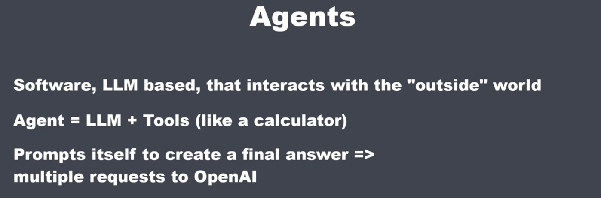
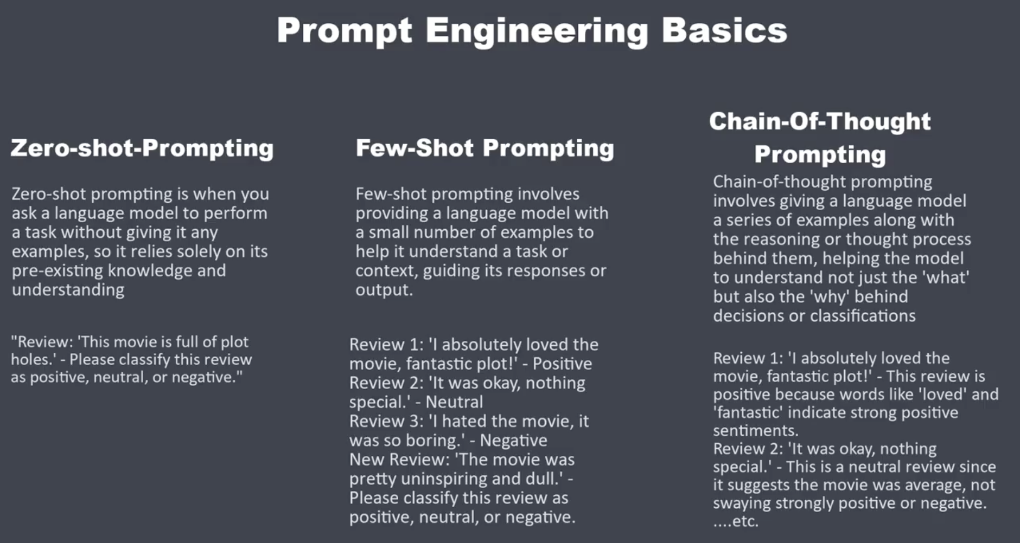

Slide 15
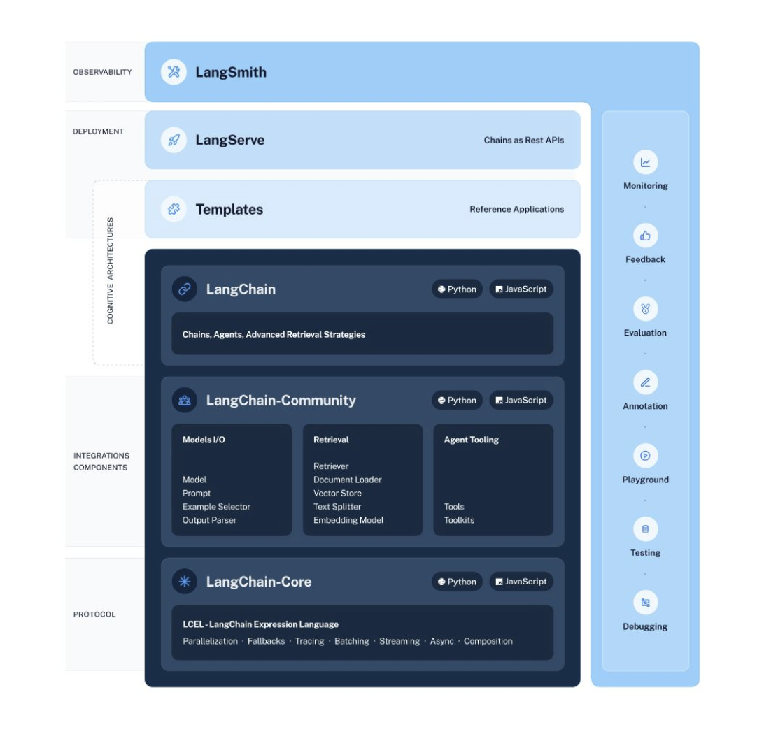

Slide 16
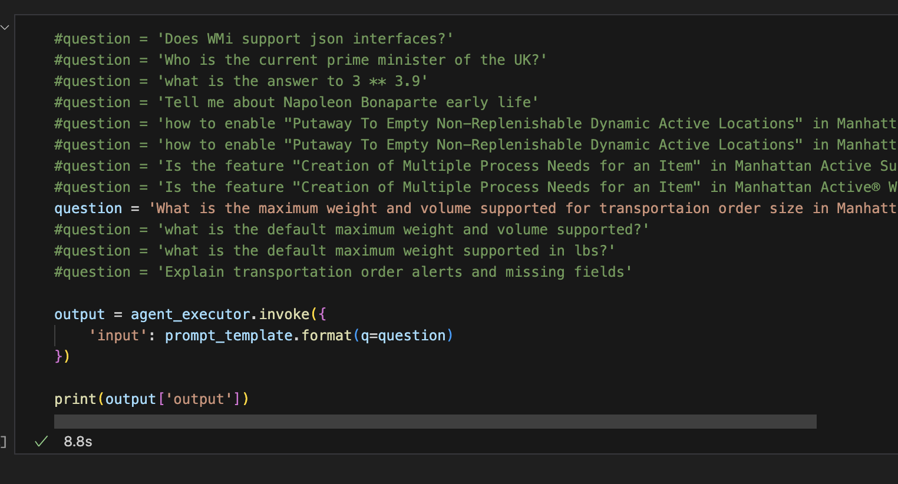
Let’s look at a code example

Slide 17
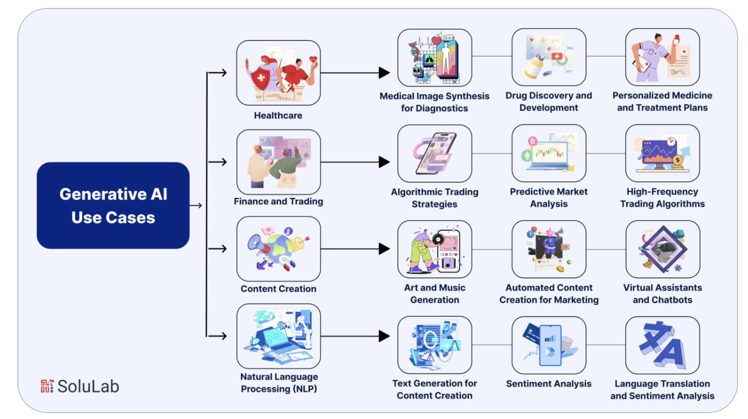
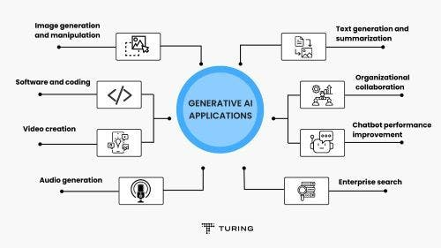
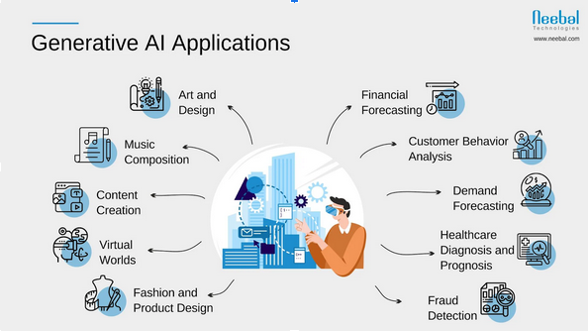
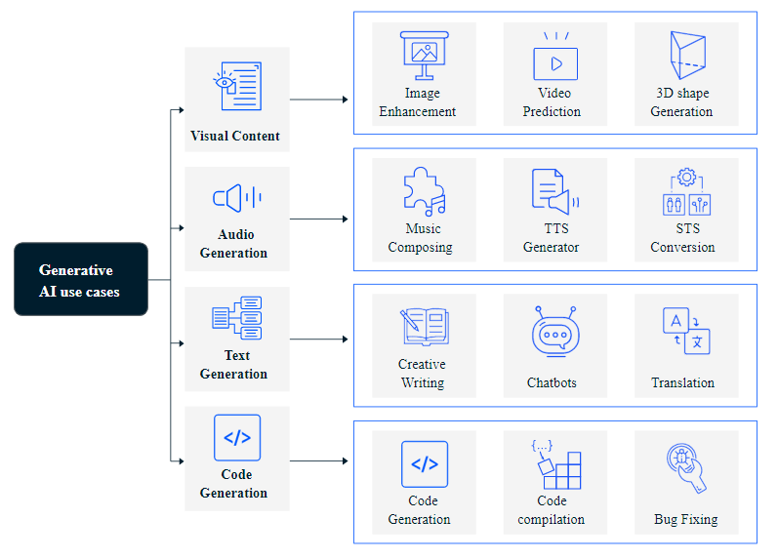

Slide 18
